Slide 1
Second Session
July 8, 2006

Slide 2
Java 2 Micro Edition
Details

Slide 3
MIDlet application model
Derived from internet Applet application model
  Simplifications for mobile environment
    Many libraries removed or simplified to fit in the memory of a mobile device
    Restrictions introduced in the previous lecture
  Modifications for mobile environment
    Management of applications
  Restrictions of mobile systems apply when using the model
    Memory usage
    Performance

Slide 4
Typical application management operations
Retrieval --- Retrieve a MIDlet suite
  medium-identification, negotiation, retrieval
Installation --- Install MIDlet suite on a device
  verification, transformation
Launch --- Invoke a MIDlet
  inspection, invocation
Version management --- Upgrade installed MIDlet suites
  inspection, version management
Removal --- Remove an installed MIDlet suite
  inspection, deletion

Slide 5
MIDlet application model
Defines the concept of an application in MIDP environment
javax.microedition.midlet
Every application must be a subclass of class MIDlet
  constructor
  startApp()
  pauseApp()
  destroyApp()
In many cases, one also implements interface CommandListener

Slide 6
MIDlet states
Unborn
constructor
destroyApp
startApp
Paused
Active
pauseApp
Created

Slide 7
Sample code: HelloMIDlet
import javax.microedition.midlet.*;
import javax.microedition.lcdui.*;
import java.util.*;
public class HelloWorld extends MIDlet implements CommandListener {
private Command exitCommand;
private TextBox tb;
public HelloWorld() {
exitCommand = new Command("exit", Command.EXIT, 1);
tb = new TextBox("HelloWorld", "Hello world!", 15, 0);
tb.addCommand(exitCommand);
tb.setCommandListener(this);
}
protected void startApp() {Display.getDisplay(this).setCurrent(tb);}
public void commandAction(Command c, Displayable d) {
if (c== exitCommand) { destroyApp(false); notifyDestroyed();}
}
protected void destroyApp(boolean u) {}
protected void pauseApp() {}
}

Slide 8
MIDlet suites
Applications are represented publicly as JAR files
  Class files
  Resource files
  Manifest that describes the JAR contents
Multiple MIDlets can reside in the same JAR file
  MIDlet suite
  Applications can share data only with those applications that are in the same MIDlet suite
  Therefore MIDlet design is an important architectural decision when aiming at larger systems
Each MIDlet suite has a short textual descriptor file
  A device user does not have to download the entire application before knowing if it will actually run in the device
  JAD file with the contents that are (almost) identical with JAR manifest

Slide 9
JAD/JAR manifest contents
MIDlet-Name --- MIDlet suite name
MIDlet-Version
MIDlet-vendor
MIDlet-Icon
MIDlet-Info-URL
MIDlet-<n> --- name, icon and class per midlet
MIDlet-Jar-URL
MIDlet-Jar-Size
MIDlet-Data-Size
MicroEdition-profile --- J2ME profile
MicroEdition-Configuration --- J2ME configuration

Slide 10
Example: JAD/JAR manifest of a simple application
MIDlet-1: HelloWorld, /HelloWorld.png, HelloWorld
MIDlet-Jar-Size: 2179
MIDlet-Jar-URL: HelloWorld.jar
MIDlet-Name: HelloWorld
MIDlet-Vendor:
MIDlet-Version: 1.0
MicroEdition-Configuration: CLDC-1.0
MicroEdition-Profile: MIDP-1.0

Slide 11
MIDlet suite execution environment
Classes and native code that implement CLDC and MIDP
  Only shared name space for all MIDlet suites
Classes within MIDlet suite’s JAR file
All non-class files in the MIDlet’s suite’s JAR file
  Icons, images, JAR manifest
  Accessible with java.lang.Class.getResourceAsStream
Contents of Application Descriptor File
  Accessible with java.lang.Class.getResourceAsStream
Separate name space for RMS record stores

Slide 12
Application: MathHangman
Simple MIDP Application
Takes around 1 hour to build
Puzzle type
Next slide shows the process flow/behaviour
Uses basic MIDP components and J2ME packages
  i.e. javax.*

Slide 13
Behavior
start
App
command
Action
check
Command
pick
Equation
draw
Equation
user

Slide 14
Imports & instance/variables
import javax.microedition.midlet.*;
import javax.microedition.lcdui.*;
public class mathHangman extends MIDlet implements CommandListener {
private Command exitCommand, rightCommand, wrongCommand;
private TextBox tb; /* Quiz canvas */
private int nth; /* Counter for equation and answer pair. */
String Questions[] = /* Questions */
{ "1 + 3 = 4",
"3 + 12 = 14",
"12 + 7 = 19",
"4 + 9 = 12",
"1 + 2 = 3",
"2 + 12 = 15",
"3 + 12 = 15",
"12 + 2 = 13",
"10 + 5 = 15",
"12 + 5 = 16" };
int Qlen = Questions.length;

Slide 15
Constructor and user actions
public mathHangman() {
exitCommand = new Command("exit", Command.EXIT, 1);
wrongCommand = new Command("WRONG", Command.CANCEL, 2);
rightCommand = new Command("RIGHT", Command.OK, 3);
}
protected void startApp() { pickEquation(); }
protected void destroyApp(boolean u) {}
protected void pauseApp() {}
public void commandAction(Command c, Displayable d) {
if (c == exitCommand) {
destroyApp(false);
notifyDestroyed();
} else ( checkCommand(c == rightCommand);
} // else
}

Slide 16
Displaying the next question
private void pickEquation(){ displayEquation(Questions[nth]);}
private void displayEquation(String equation) {
tb = new TextBox(”mathHangman", equation, 15, 0);
tb.addCommand(wrongCommand);
tb.addCommand(rightCommand);
tb.setCommandListener(this);
Display.getDisplay(this).setCurrent(tb);
}

Slide 17
Calculating if the answer is correct
private void checkCommand(boolean b) {
if(((nth%2) == i) = b) {
tb = new TextBox("mathHangman",
"You failed the challenge", 30, 0);
tb.addCommand(exitCommand);
tb.setCommandListener(this);
Display.getDisplay(this).setCurrent(tb);
} else {
nth = nth + 1;
if (nth == Qlen) {
tb = new TextBox("mathHangman",
"You mastered the challenge", 30, 0);
tb.addCommand(exitCommand);
tb.setCommandListener(this);
Display.getDisplay(this).setCurrent(tb);
} else {
pickEquation();
}
}
}
} // class mathHangman

Slide 18
Special libraries and interfaces
UI
  Different devices
    Different screen capabilities (e.g. screen, color, ...)
    Different input mechanisms (keyboard, touch screen, ...)
Networking interface
  http focused
  No link to final implementation-level protocol
Persistence
  RMS, record management system
  Reflects a simple, record-oriented database
    Records interfaced with byte arrays

Slide 19
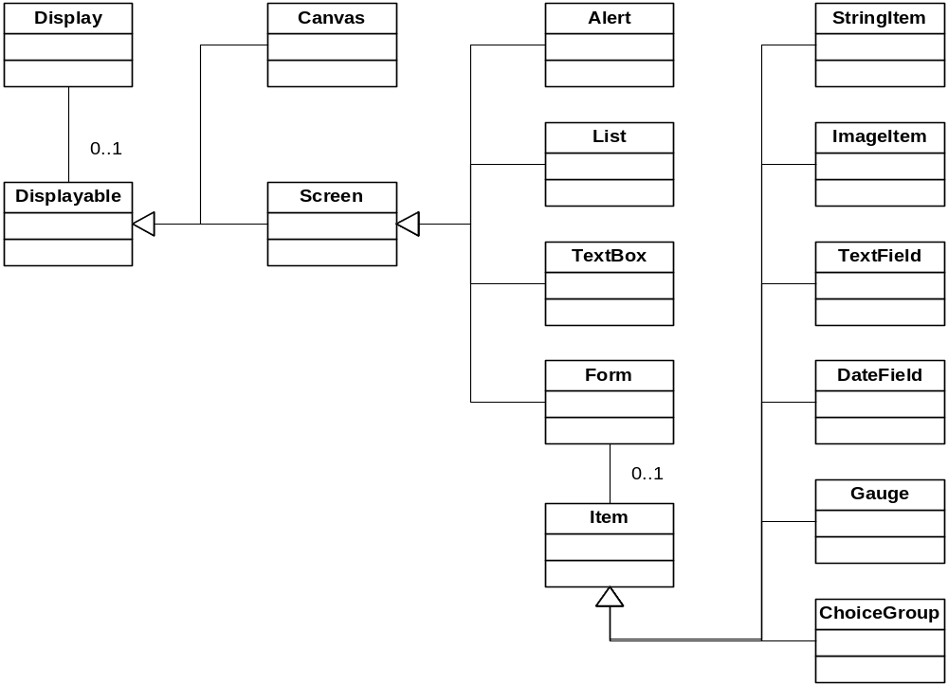
UI class hierarchy (MIDP 1.0)

Slide 20
Explaining the hierarchy
Canvas
  Low-level interface
  Application to provide graphics and handle input
    Control what is drawn
    Handle primitive events (e.g. key presses)
    Access concrete keys & other input devices
Screen
  High-level interface
  High-level objects that encapsulate a complete user interface component
    Drawing by system software
    Navigation, scrolling etc handled by system software
    Applications cannot access concrete input mechanism

Slide 21
Other screen-related issues
Game API (MIDP 2.0)
  Sprites and Layering
  Enables native implementation
GUI enhancements
  Builds on MIDP 1.0 LCDUI
  Custom items, layout control, graphical enhancements...
  Backward compatibility

Slide 22
MIDP 2.0 adds more features
OTA (over the air) applications
  Installation
    Verify integrity, certificates, requested permissions
  Invocation
    Permissions
  Previously extension, now required
Networking extensions
  HTTPS, SSL
  Serial port
  Sockets
  Server Sockets
  Datagrams
  Network push feature
    Network initiated MIDlet launch

Slide 23
Other services
Timers
class myTask extends TimerTask {
public void run() { ... }
}
myTimer = new Timer();
myTask = new myTask();
myTimer.schedule(myTask, 100, 1000);
Access to resource files (getResourceAsStream)
System properties (java.lang.System.GetProperty)
  microedition.platform (laitteen nimi)
  microedition.encoding (käytetyn merkistön enkoodaus)
  microedition.configuration (käytetty konfiguraatio ja sen versio)
  microedition.profiles (käytetty profiili ja sen versio)
  microedition.locale (kieli ja maa)

Slide 24
J2ME extensions
JSR-120: Wireless Messaging API
  Short Message Service (SMS)
  Unstructured Supplementary Service Data (USSD)
  Cell Broadcast Service (CBS)
JSR-135: Mobile Media API
  Straightforward access and control of basic audio and multimedia resources and files
JSR-172: J2MET Web Services Specification
  Infrastructure for basic XML processing capabilities
  Reuse of web service concepts when designing J2ME clients for enterprise services
  Provides APIs and conventions for programming J2ME clients of enterprise services
  Programming model for J2ME client communication with web services, consistent with that for other Java clients such as J2SE.

Slide 25
J2ME extensions
JSR-177: Security and Trust Services for J2MET
  Necessary step for a device to become trusted, i.e., to provide security mechanisms to support a wide variety of application-based services, such as access to corporate network,mobile commerce, and digital rights management
  Model and a set of APIs that enable applications running on a J2ME device to communicate with a smartcard
JSR-179: Location API for J2MET
  Optional package that enables developers to write mobile, location-based applications for J2ME devices
JSR-180: Session Initiation Protocol (SIP) for J2MET
  Session Initiation Protocol (SIP) is used to establish and manage multimedia IP sessions
  General SIP API for J2ME devices based on the SIP protocol defined by IETF and 3GPP, and targeting resource constrained platforms.

Slide 26
J2ME extensions
JSR-184: Mobile 3D Graphics for J2MET
  lightweight, interactive 3D graphics API, which sits alongside J2ME and MIDP as an optional package.
  API targeted at devices that typically have very little processing power and memory, and no hardware support for 3D graphics or floating point math
JSR-190: Event Tracking API for J2MET
  Optional package that standardizes the tracking of application events in a mobile device
  Submission of these event records to an event-tracking server via a standard protocol
JSR-195: Information Module Profile

Slide 27
J2ME extensions
JSR-68: J2MET Platform Specification
  Defines the"ground rules" for the J2ME platform architecture and J2MEstandardization activities.
  Formalizes the fundamental concepts behind J2ME, such as the notions of a configuration and profile
  Defines how new J2ME APIs can be formed, e.g., by subsetting existingAPIs from Java 2 Platform, Standard Edition
JSR-185: JavaT Technology for Wireless Industry
  Defines how various technologies associated with MIDP work together to form a complete handset solution for the wireless services industry
  Which optional packages fit with which profiles? How an end-to-end solution for interoperable Java applications will work?How the migration of applications can occur and to which profiles as the devices become more capable?

Slide 28
First Issue:
Event Handling

Slide 29
MIDP’s High-Level Interface
High-Level MIDP events are divided into two categories:
  Command : events triggered by keypresses on the device
  Items: events that are the results of visual components changing on the display

Slide 30
Command Objects
When an event occurs on a mobile device, a Command Object holds information about that event
Commands are commonly represented with soft-buttons on the device
The information includes:
  Type of command executed
  Label of the command
  Priority

Slide 31
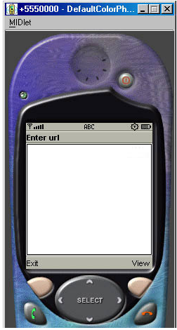
Command Objects
Figure at the right shows two command objects, one labeled Exit and the other View
If the current display cannot hold multiple command objects, a menu may be created to hold the objects

Slide 32
Event Processing
The only MIDP components that can manage commands are the following:
  Form
  TextBox
  Lixt
  Canvas
These will be illustrated later in the discussion

Slide 33
Event Processing
The basic steps to process events with Command objects are as follows:
  Create a Command Object
  Add the Command to a Form, TextBox, List or Canvas
  Create a Listener
Upon detection of an event, the Listener generates a call to the method commandAction()

Slide 34
Command Processing Example
The following code block shows an event procedure using a Command Object:
private Form fmMain;
private Command cmExit;
. . .
// Create Form and give it a title
fmMain = new Form(“My Form");
// Create Command object, with label, type and priority
cmExit = new Command("Exit", Command.EXIT, 1);
. . .
fmMain.addCommand(cmExit); // Add Command to Form
fmMain.setCommandListener(this); // Listen for Form events
. . .
public void commandAction(Command c, Displayable s)
{
if (c == cmExit)
{
destroyApp(true);
notifyDestroyed();
}
}

Slide 35
Item Objects
It is also possible to process events using Item Objects in MIDP
Several of these Items are predefined for processing particular event types, for example:
  DateField: allows the user to select the date and time that will display on screen
  TextField: allows the user to enter a series of alpha-numeric and special characters

Slide 36
Event Processing
With the exception of StringItem, Spacer, and ImageItem, each Item object has the ability to recognize events
An event listener must be created before events from Item objects are acknowledged by the device
When a change occurs in any Item Object, the method itemStateChanged() is called
Within this method, you can identify which Item Object generated the event

Slide 37
Item Processing Example
The following code block shows simple event processing for a DateField Item Object:
private Form fmMain;
private DateField dfToday; // DateField Item
. . .
fmMain = new Form("Core J2ME"); // Create Form object
// Create DateField
dfToday = new DateField("Today:", DateField.DATE);
. . .
fmMain.append(dfToday); // Add DateField to Form
fmMain.setItemStateListener(this);
// Listen for Form events
. . .
public void itemStateChanged(Item item)
{
// If the datefield initiated this event
if (item == dfToday)
...
}

Slide 38
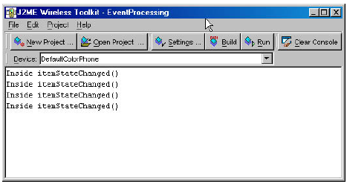
Detecting Item Events
In our example MIDlet, as each character is input, an Item event is generated
Monitor the WTK console to see that the print message we placed inside the method ItemStateChanged() are displayed

Slide 39
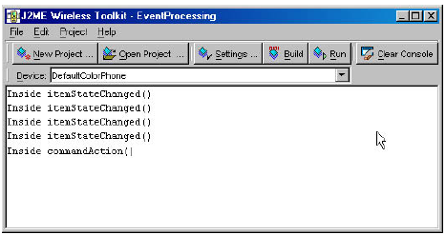
Detecting Command Events
When we chose to exit the MIDlet by pressing the soft-button with the Exit label, a Command event was generated
The appropriate actions were taken inside the commandAction() method, this can be seen in the WTK console as well

Slide 40
Display Objects
These objects are designed to work with the device display:
  Display
  Displayable
  Screen
All three components comprise MIDP’s device display mechanism

Slide 41
Display Object
A MIDlet has one instance of a Display Object
Gives information about the current device display such as color support
Includes methods for requesting that other objects be displayed
Works as the manager of the device display controlling everything that can be seen on the device display

Slide 42
Displayable Object
Although there is only one Display object per MIDlet, many objects within the MIDlet may have a displayable attribute
The Displayable Object in MIDP contains two subclasses:
  Screen
  Canvas
The following are the class definitions for each:
abstract public class Displayable
public abstract class Canvas extends Displayable
public abstract class Screen extends Displayable

Slide 43
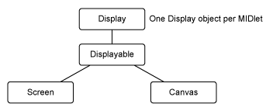
Display Object Hierarchy

Slide 44
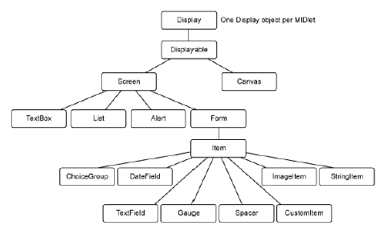
Screen Object
Screen Objects are those that are visible on the device
It has several subclasses shown below:

Slide 45
MIDP’s Low-Level Interface
Low-Level UI provides a toolkit to do the following:
  Move and draw graphics object
  Render fonts
  Capture direct key events
Two classes really make up the low-level UI engine:
  Canvas: a Displayable object (similar to Screen Object)
  Graphics: also called the context, is the palette of tools with which to draw

Slide 46
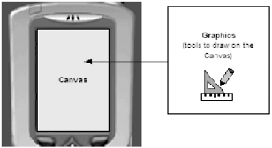
Canvas and Graphics Relationship

Slide 47
The Canvas Object
Canvas objects are not created similar to other Displayable objects
This object serves as a base class from which you derive custom drawing objects
In other words, the Canvas object provides the all the tools, but the user gives the content
To invoke the object you derived from the Canvas class, the following method must be called:
protected void paint(Graphics graphics)
This method is responsible for rendering or drawing the Canvas control on to the screen

Slide 48
Canvas: Example
First you have to get a handle to the Canvas object, this is done by declaring an instance of the object in the MIDlet.
The Canvas class is extended to the users custom made Canvas tool
class TestCanvas extends Canvas implements CommandListener
{
private Command cmdExit;
. . .
display = Display.getDisplay(this);
cmdExit = new Command("Exit", Command.EXIT, 1);
addCommand(cmdExit);
setCommandListener(this);
. . .
protected void paint(Graphics g)
{
// here goes the user’s routines for drawing and object movement
}
}
// create an instance of the Canvas
TestCanvas canvas = new TestCanvas(this);

Slide 49
Continued. . .
the paint() method, which is activated everytime an event on the Canvas (display) object occurs, should contain the draw and move routines for the MIDlet
Example below shows initial setup of the Canvas object
protected void paint(Graphics g)
{
// Set background color to white
g.setColor(255, 255, 255);
// Fill the entire canvas
g.fillRect(0, 0, getWidth(), getHeight());
}

Slide 50
Event Handling in Canvas Objects
Similar to Screen and other Displayable objects, the Canvas object may implement a CommandListener to process events
The commandAction() method contains the events trapped by sift-key buttons
The Canvas object also has access to 12 constant key-codes defining the mobile device keys:
KEY_NUM0, KEY_NUM1, . . ., KEY_NUM9,
KEY_STAR and KEY_POUND
These keys are what comprises the keypad on mobile phones.
There are exceptions on phones like the Nokia N-Gage, where the keys are placed differently

Slide 51
KeyCodes
To process the key codes (trap the user input on the keypad), the following methods are intuitively defined in MIDP:
void keypressed(int keyCode)
void keyReleased(int keyCode)
void keyRepeated(int keyCode)
boolean hasRepeatEvents()
` String getKeyName(int keyCode)
Among the five methods, the keyRepeated() and hasRepeatEvents() doesn’t appear frequently on Game programs, since they are used to identify which letter-character is desired on a given key (i.e for ‘b’ you need to press KEY_NUM1 twice)

Slide 52
Game Specific Keys
The User may map the keys on the keypad to game specific actions, typically we have the following:
UP, DOWN, LEFT, RIGHT, FIRE,
GAME_A, … GAME_Z
Key assignment vary from device to device, most phones in the series 40 and series 60 have similar configurations
If a device doesn’t have directional arrows, the left, right, down and up actions are assigned to keypad numbers 6, 4, 2, and 8 respectively

Slide 53
Processing Game Actions
All user initiated game actions are processed through key presses and the appropriate device reaction must be placed under one of the five key processing methods
Example below shows how different keypresses may direct the action of a character in a game:
protected void keyPressed(int keyCode)
{
switch (getGameAction(keyCode))
{
case Canvas.FIRE:
shoot();
break;
case Canvas.RIGHT:
goRight();
break;
. . .
}
}

Slide 54
Graphics Class
Among the various objects used for J2ME game development, the Graphics class is the most extensive
The Graphics class provides the facility to manipulate different Displayable aspects such as:
  Color
  KeyStrokes and BrushStrokes
  Shapes
  Fonts
  Links or Anchor Points
  Graphical Text
  Images and Pictures

Slide 55
Graphics Class and Canvas Connection
The Graphics Class drawing tools are used to carry out basic 2D rendering on th Canvas object.
Most attributes of the Graphics Class are shared with the Canvas Object, this translates to automatic configuration of both even when only one is manipulated

Slide 56
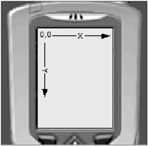
Coordinates
Before we go further, we need to know the coordinate system in an MIDP display
The origin is located on the display at the top left corner
This is assigned the XY value (0,0)

Slide 57
Coordinates
All draw methods (graphics) take coordinates according to the same format
However, it is possible to change the origin on the screen, for example:
graphics.drawRect(25, 25, 10, 10);
This code will result in a rectangle appearing at position (25,25) and extending for 10 pixels in both directions
Now we can translate the whole display world 50 pixels on the y-Axis only through:
graphics.translate(0,50);
graphics.drawRect(25, 25, 10, 10);
The second rectangle is now drawn lower on the screen (see next slide)

Slide 58
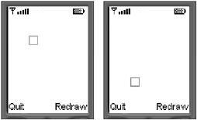
Coordinates
You should note that multiple calls to translate are cumulative for the same display object like canvas or graphics
Therefore, the following code will set a translation of (20,70), not (20,20)
You can also use negative numbers to adjust the translation

Slide 59
End of Session

